Slide 1


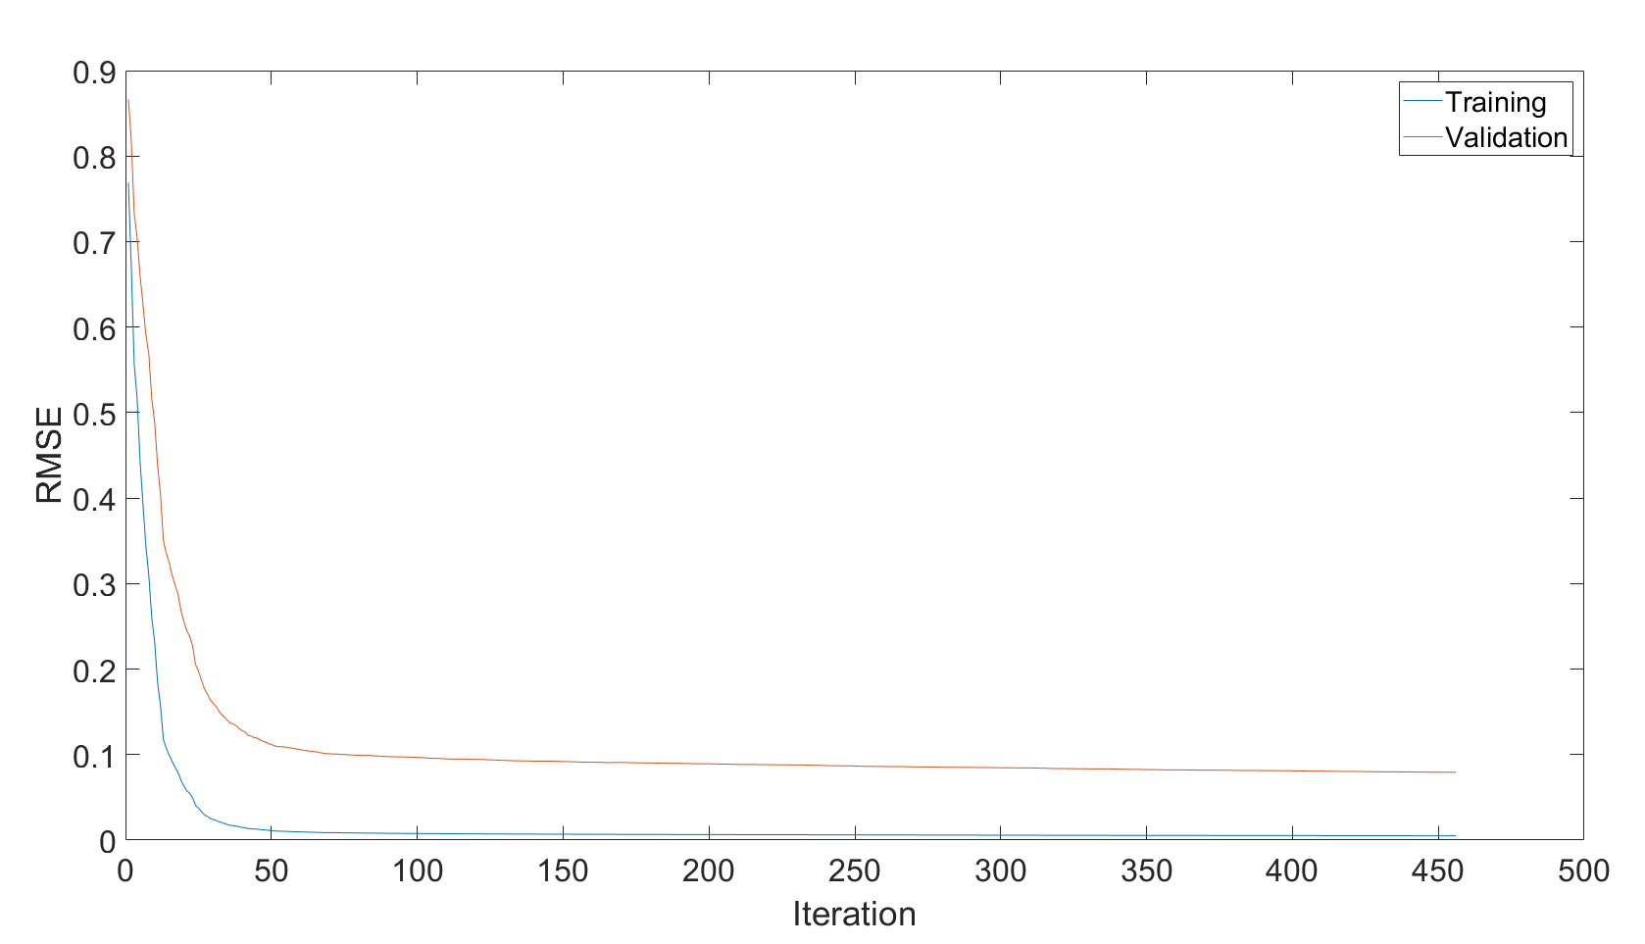
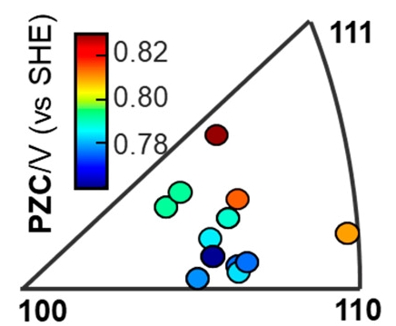
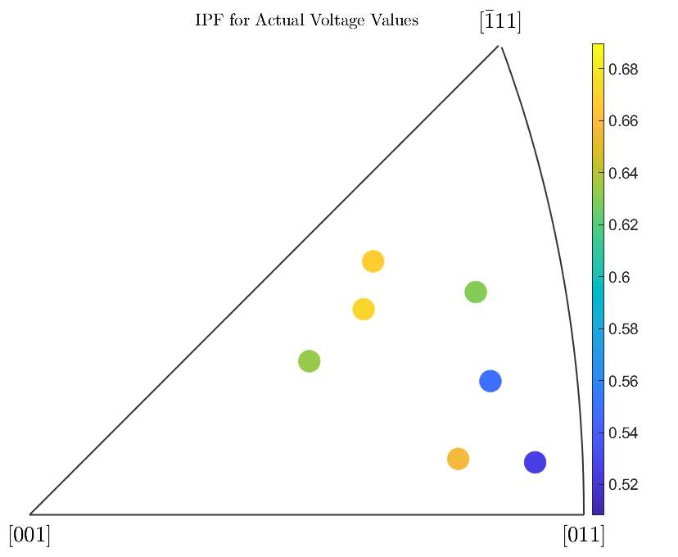
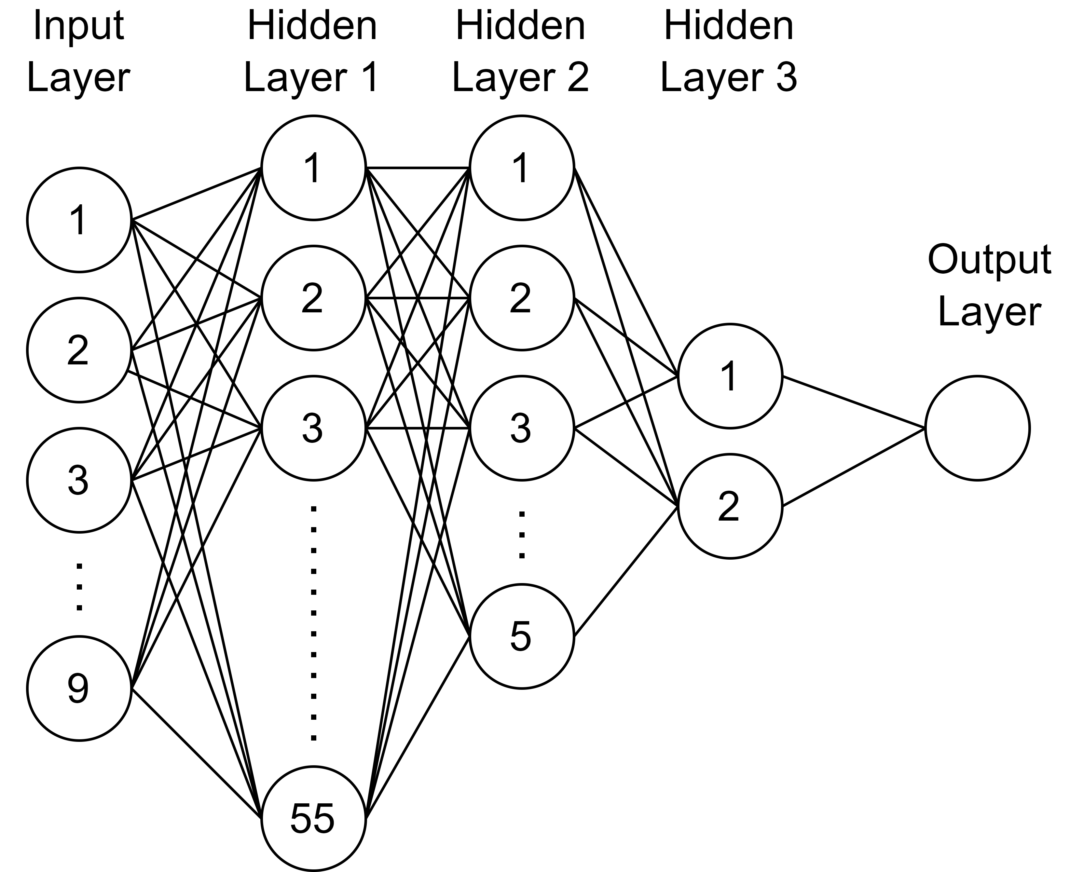
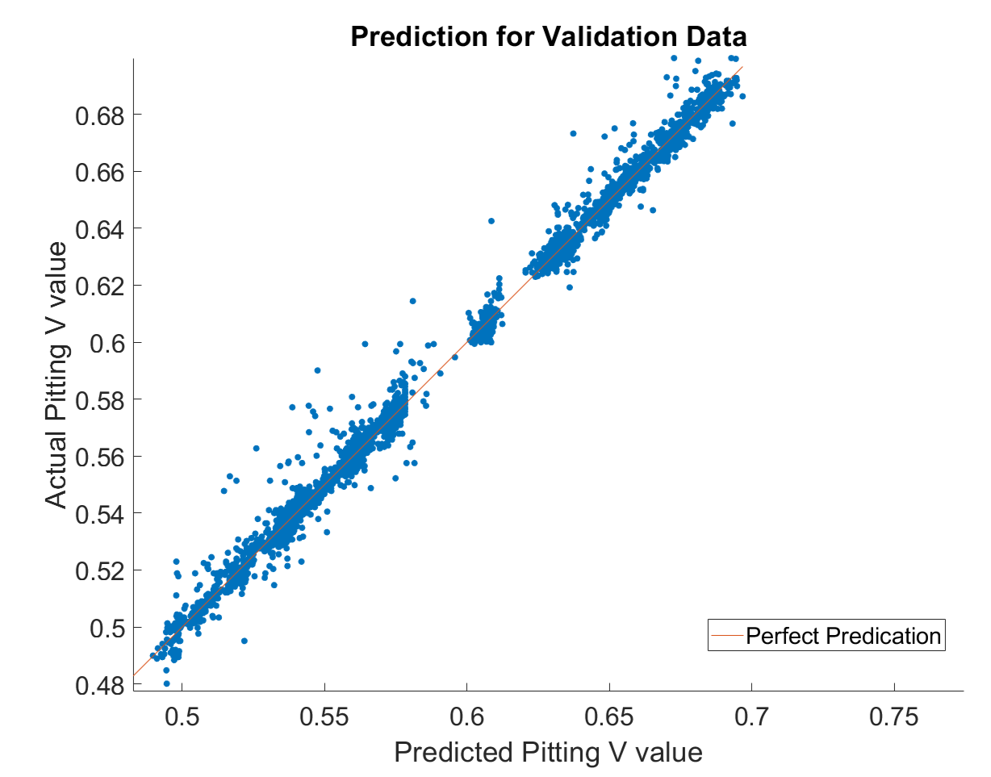
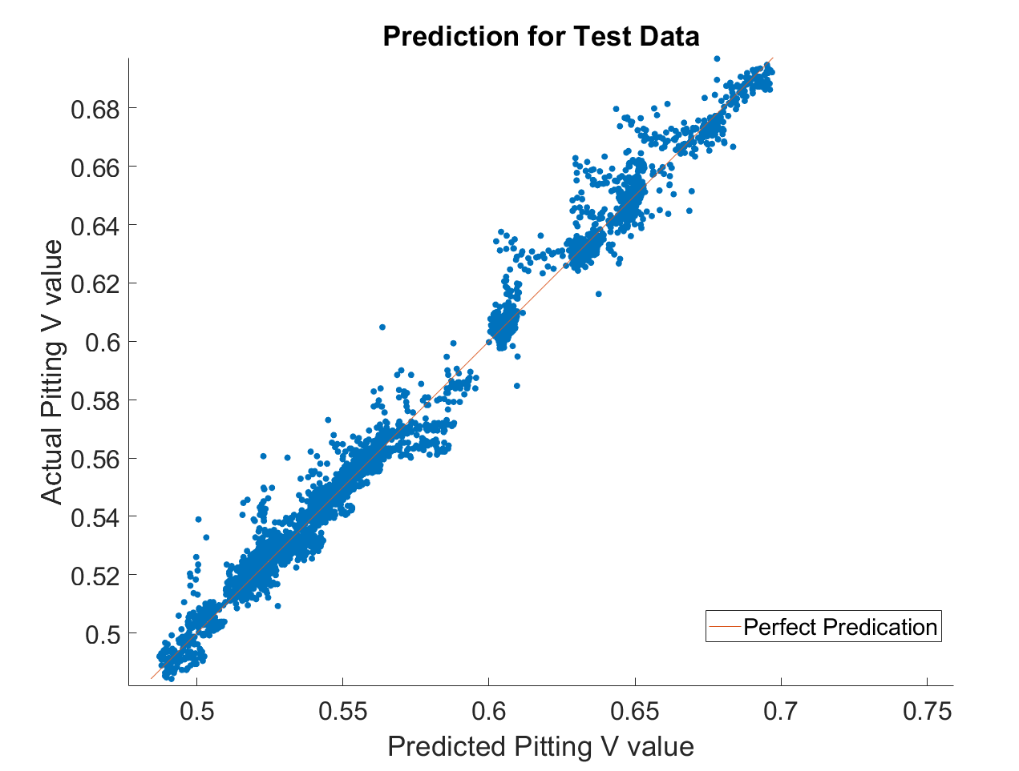
Comprehending Nano-Scale Corrosion Behavior using Multi- Layered Perceptron for Regression
Tripathi, Saugat¹; Pitkar, Ashutosh M.²; Wang, Miao¹; Zhang, Ran¹; Ye, Zhijiang²
¹ Department of Electrical and Computer Engineering, Miami University, Oxford, OH, USA
² Department of Mechanical and Manufacturing Engineering, Miami University, Oxford, OH, USA
Abstract
Corrosion impact almost 3.4% of global GDP.
Complexity and lack of understanding of nucleation process of corrosion.
Ongoing research suggests crystal features and orientation and electrochemical behavior associated with corrosion.
Integrated data obtained from scanning electrochemical cell microscopy (SECCM) and electron backscatter diffraction (EBSD) experiment.
Proposed work exploits multi-layered perceptron (MLP) for regression based deep learning (DL) approach on integrated data to develop a model.
Developed model can predict corrosion behavior with satisfying accuracy.
Demonstrate that the behavior are related not only to the grain orientation but also to irregularities of grain surface.
Methodology
Image processing-based matching SECCM datapoints with EBSD orientation and grain information.
MLP Based Regression Model
Three-layer neural network with limited memory Broyden Fletcher Goldfarb Shanno quasi-Newton algorithm (LBFGS) solver to minimize loss function.
Developed MLP structure consists of 55, 55, 2 nodes on first, second and third layer, respectively and ReLu function is used as activation function.
Input features used
Position coordinate (XYZ of every datapoint from SECCM experiment)
Euler angle (Orientation feature obtained from EBSD)
Z gradient with respect to both X and Y
Current at pitting condition
Output response
Corresponding voltage at pitting condition
Results
a
Figure 2 – Training progress using the all-available input features of XYZ, Euler Angle, Gradient of Z with respect to X and Y, and Current value for CV pair
b
Figure 1 – MLP Structure
Research GAP
Recent research shows a close relationship between crystal orientation and electrochemical properties. [1][3]
Potential of zero charge (PZC) has been seen to correlate with the local grain crystal orientation. [1]
Although the relationship was observed, is the orientation information enough to predict the nano-scale electro-chemical behavior?
Or are there other features that also play role in the corrosion behavior?
c
Figure 4 – IPF plot with pitting voltage values represented against the crystal orientation. The color represents the average predicted voltage and position represents the orientation of that grain. (a) Results of PZC/V (Potential of Zero Charge) as a function of orientation. Adapted with permission Ref [1]. Copyright 2020 American Chemical Society. (b) IPF plot with color representing actual voltage value for test data. (c) IPF against predicted test voltage using developed model.
Contribution
Image processing-based approach for SECCM and EBSD data integration.
Development of MLP-Regression model that predicts the corrosion behavior of grains of silver.
Conclusion and Future Works
Training Setup
Model setup was done in MATLAB environment with Bayseian optimizer for hyperparameter tuning.
Separate combinations of input features were used for the training to compare the performance.
Due to the limited availability of the data set three different Current-Voltage pair data obtained from SECCM experiments were used.
In the preprocessing, outliers present on the data were removed and data was normalized to z-score values.
From the whole dataset 7 grains obtained from whole experiment were isolated as testing data.
The remaining dataset was split into 75%-25% training and validation data.
Finally, to represent the result, predicted vs actual voltage value and IPF are plotted.
Developed MLP model for regression can predict the corrosion behavior with satisfactory accuracy for silver.
Results indicate behavior are related to grain orientation as well as irregularities in grain surface.
Can be further expanded to achieve higher accuracy with more data from simulations and experiments.
Future development towards oracle system that predicts corrosion with full C-V curve for different materials.
Highlights
Use of EBSD and SECCM data in the deep learning model.
Corrosion behavior depended not only to grain orientation but also to ups and downs.
Regression model based on deep learning axiom that can predict the electrochemical behavior based on the grain orientation and surface features.
Figure 3 – Actual Pitting Voltage Value vs Predicted Pitting Voltage value for Test (bottom) and Validation data (top)
Validation and the training RMSE value is decreasing with the number of iteration and showing a proper learning curve of the model.
Combined use of surface feature and orientation data as input feature showed lower RMSE value and higher prediction accuracy.
The trained model is able to predict the corresponding value of voltage with RMSE value of 0.0794 and 0.1146 for validation and test data, respectively.
References
[1] | Y. Wang, E. Gordon and R. Hang, "Mapping the Potential of Zero Charge and Electrocatalytic Activity of Metal−Electrolyte Interface via a Grain-by-Grain Approach," Analytical Chemistry, vol. 92, no. 3, pp. 2859-2865, 2020.
[2] | O. Wahab, M. Kang and P. R. Unwin, "Scanning electrochemical cell microscopy: A natural technique for single entity electrochemistry," Current Opinion in Electrochemistry, vol. 128, p. 120, 2020.
[3] | X. Zhang, X. Zhou, T. Hashimoto, J. Lindsay, O. Ciuca, C. Luo, Z. Sun, X. Zhang and Z. Tang, "The influence of grain structure on the corrosion behaviour of 2A97-T3 Al-Cu-Li alloy," Corrosion Science, vol. 116, pp. 14-21, 2017.

